Slide 1
Introduction To Java

Slide 2
Java History
1) JAVA was developed by Sun Microsystems Inc in 1991, later acquired by Oracle Corporation.
2) It was developed by James Gosling and Patrick Naughton and team called as green team.
3) Initially it developed for electronic devices like set-up box, television etc. However, it was suited for internet programming
4) Later, Java technology was incorporated by Netscape.
5) It is a simple programming language. Writing, compiling and debugging a program is easy in java.
6) It helps to create modular programs and reusable code.
7) Firstly, it was called "Greentalk" by James Gosling, and the file extension was .gt.
8) After that, it was called Oak and was developed as a part of the Green project.
9) Oak is a symbol of strength and a national tree of many countries like the U.S.A., France, Germany, Romania, etc.
10) In 1995, Oak was renamed as "Java" because it was already a trademark by Oak Technologies.

Slide 3
Java Versions
JDK Alpha and Beta (1995)
JDK 1.0 (23rd Jan 1996)
JDK 1.1 (19th Feb 1997)
J2SE 1.2 (8th Dec 1998)
J2SE 1.3 (8th May 2000)
J2SE 1.4 (6th Feb 2002)
J2SE 5.0 (30th Sep 2004)
Java SE 6 (11th Dec 2006)
Java SE 7 (28th July 2011) LTS
Java SE 8 (18th Mar 2014) LTS
Java SE 9 (21st Sep 2017)
Java SE 10 (20th Mar 2018)
Java SE 11 (Sept 2018) LTS
Java SE 12 (Mar 2019)
Java SE 13 (Sept 2019)
Java SE 14 (Mar 2020)
Java SE 15 (Sept 2020)
Java SE 16 (Mar 2021)
Java SE 17 (Sept 2021)

Slide 4
Features of Java
1) Simple :
It’s easy to learn as its syntax is similar to english .
If you know c and c++ then its more easy to learn Java.
2) Object-Oriented
Each and everything in java is based on object
OOPS is based on four pillars Encapsulation, Polymorphism, Inheritance , Abstraction
3) Secure
Java programs are checked for error at compile time and run time.
When we compile java code it creates .class file which is in unreadable format.
4) Platform Independent
Java programs created on one platforms can run on any platform
5) Interpreted
Each and every code in java is interpreted at runtime

Slide 5
C++ Vs Java
C++ | Java
C++ is platform-dependent. | Java is platform-independent.
C++ is mainly used for system programming. | Java is used for application programming. It is mostly used in window, web-based, enterprise and mobile applications.
C++ supports multiple inheritance. | Java doesn't support multiple inheritance through class. It can be achieved by interfaces in java.
C++ supports pointers. You can write pointer program in C++. | Java supports pointer internally. However, you can't write the pointer program in java. It means java has restricted pointer support in java.
C++ supports both call by value and call by reference. | Java supports call by value only. There is no call by reference in java.
C++ is nearer to hardware. | Java is not so interactive with hardware.

Slide 6
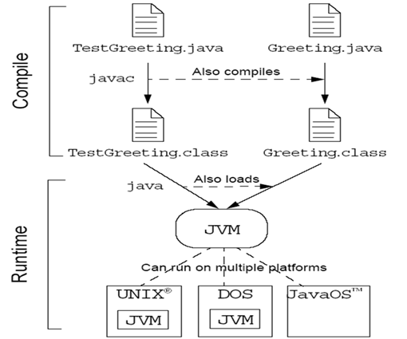
Program Execution

Slide 7
Java Architecture
The Java Virtual Machine (JVM)
Garbage collection
The Java Runtime Environment (JRE)

Slide 8
Java Virtual Machine(JVM)
The JVM specification provides the hardware platform specifications to which you compile all Java technology code.
This specification enables the Java software to be
platform-independent because the compilation is done for a generic machine, known as the JVM.
The compiler takes the Java application source code and generates bytecodes.
Bytecodes are machine code instructions for the JVM.

Slide 9
Garbage Collection
Checks and frees memory that is no longer needed.
Provides a system-level thread to track memory allocation.
Happens automatically during the lifetime of a Java program

Slide 10
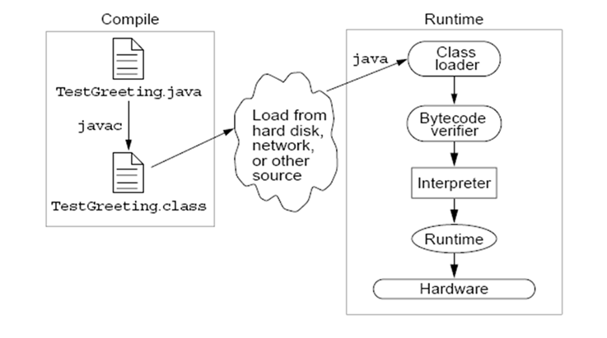
Java Runtime Environment (JRE)

Slide 11
Java Runtime Environment (JRE)
The Java Runtime Environment (JRE) is a set of software tools for development of Java applications.
It combines the Java Virtual Machine (JVM), platform core classes and supporting libraries.
JRE is part of the Java Development Kit (JDK), but can be downloaded separately.

Slide 12
Components of the JVM
JVM for different platforms use different techniques to execute the bytecode.
The major components of JVM are:
Class loader
Execution engine
Just In Time (JIT) compiler

Slide 13
JVM Tasks
Loading: It is performed by the class loader to load the code.
Verifying: It is performed by the bytecode verifier to verify the code.
Executing: It is performed by the runtime interpreter to execute the code.

Slide 14
Class Loader
Loads all classes necessary for the execution of a program.
Adds security by separating the namespaces for the classes of the local file system from those imported from network sources.
A JVM can have following types of class loaders:
Primordial class loader: Loads the Java API classes required by the running Java program.
Class loader objects: Loads the classes of the Java application program. An application can create class loaders at runtime to load the classes of the application.

Slide 15
Bytecode Verifier
The JVM puts the code through a bytecode verifier that tests the format of code fragments and checks code fragments for illegal code.
The bytecode verifier ensures that:
The code adheres to the JVM specifications and does not violate system integrity.
The types of parameters for all operational codes are correct.
No illegal data conversions, such as converting integers to object references, have occurred.

Slide 16
Execution Engine
The Java execution engine is a component of the JVM that runs the bytecode one line after another.
The execution engines implemented by different vendors use different techniques to run the bytecode.
The Java execution engine converts the bytecode to the machine object code and runs it.

Slide 17
JIT Compiler
The JIT compiler is used for compiling the bytecode into executable code.
The JVM runs the JIT compiled code without interpreting it because the JIT-compiled code is in the machine code format.
Running the JIT-compiled code is faster than running the interpreted code because it is compiled and does not require to be run, line after line.

